Slide 1
LED board rework SOP
2020/08/24

Slide 2
I2C conflicts with AD82584F and LP5036
AD82584F I2C address: 0x31
LP5036 I2C address: 0x30~0x33
Current design is 0x30 and 0x31, so 0x31 of LP5036 needs to change as 0x33 due to easy for rework.
LP5036 is located in 96.1515T00* LED board of 96.1529T00*.
U3_1 and U3_2 are LP5036 and needs to change U3_2 I2C address.
  U3_2: 0x31→0x33, ADDR1=GND→ ADDR1=Vcc3.3.
Currently LED I2C address | LED Driver
0x2A | U3_3(LP5024)
0x30 | U3_1(LP5036)
0x31(conflict) | - U3_2(LP5036) - AD82584F
0x32
0x33
Note *: 96.1515T00: LED board, 96.1529T00: panel of Sub board

Slide 3
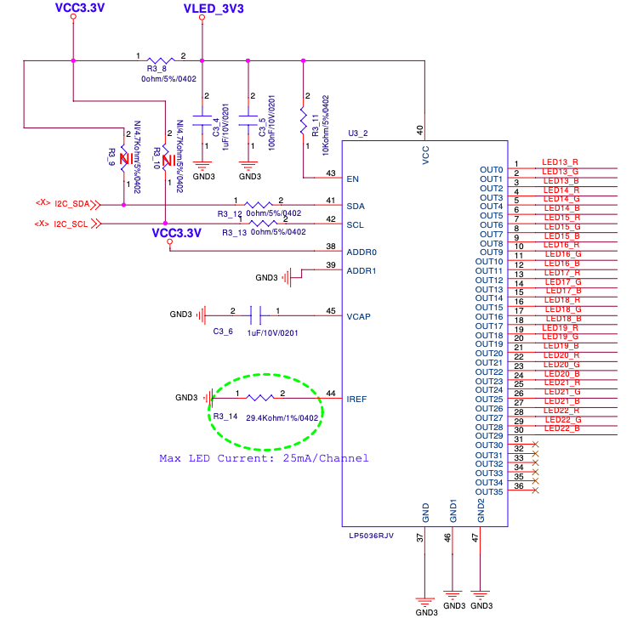
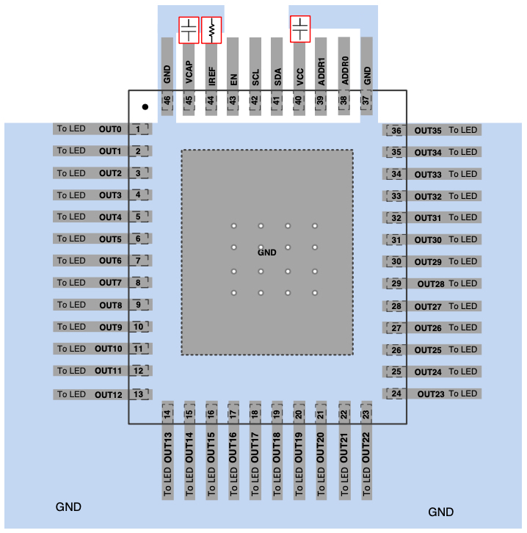
U3_2(LP5036) rework pin
Schematic of LED board: 96.1515T00

Slide 4
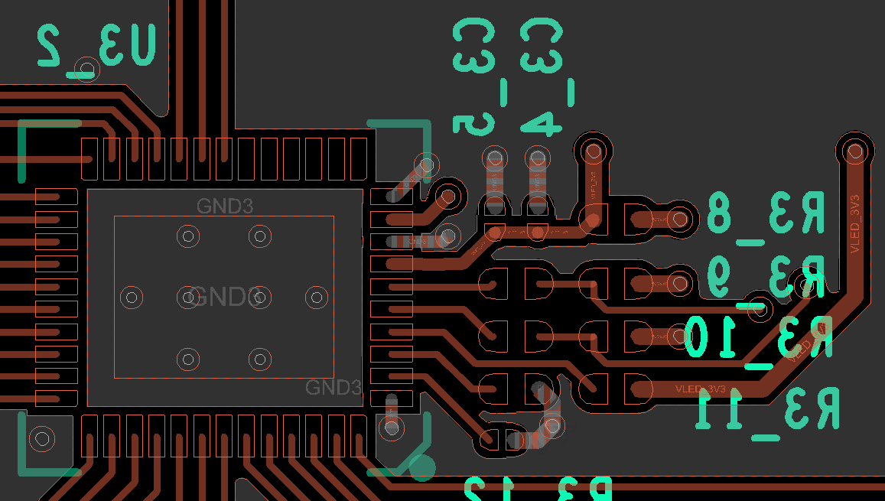
Layout of U3_2
Cut off line
Rework steps:
Cut off GND at Pin 39.
Shorten Pin38 and Pin39 by solder.
Pin38: ADDR0
Pin39: ADDR1
Shorten these 2 pin:
Pin38 and Pin39
U3_2: LP5036

Slide 5
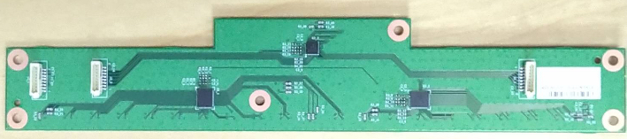
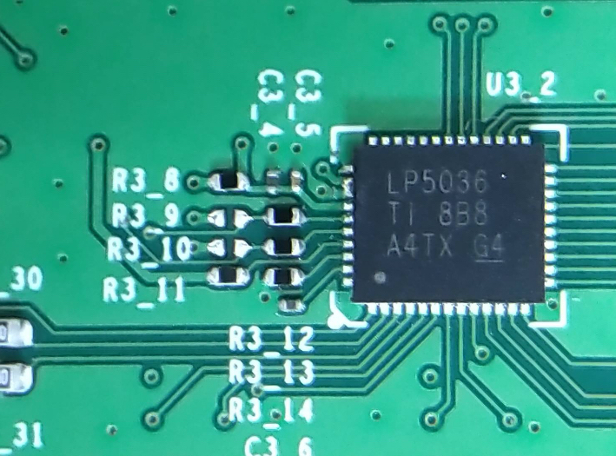
Finished rework
U3_2: LP5036
Pin39
Pin38
1. Cut off net
2. Soldering together

Slide 6
Rework U3_2(LP5036) for I2C address
After rework, the LED driver function is ok for 0x31→0x33 of U3_2(LP5036) verified by SW team.
Need 2 steps to rework
  Cut off net of Pin39
  Solder Pin38 and Pin39 together.
QFN package is small and a little bit difficult to rework.

Slide 7
Audio AMP rework SOP
2020/08/31

Slide 8
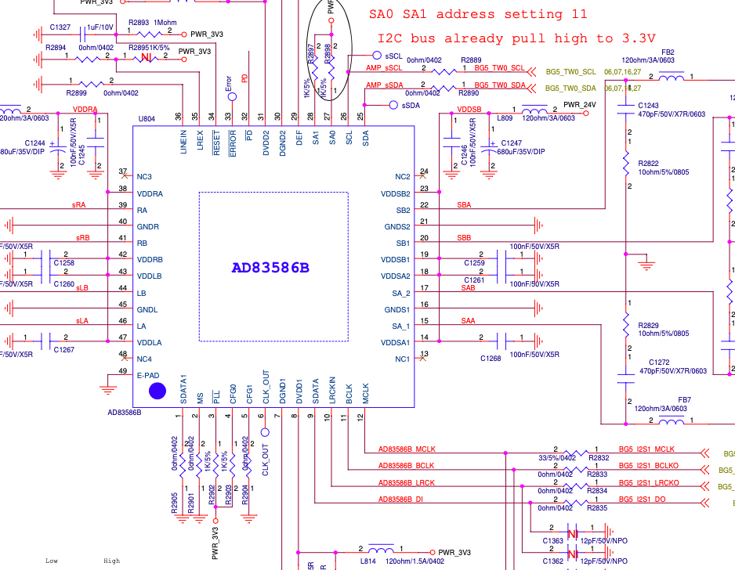
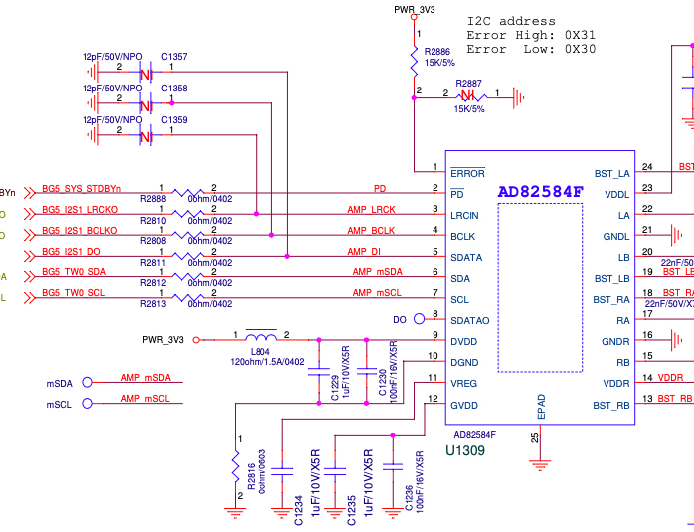
AD83586B & AD83584F-Schematic

Slide 9
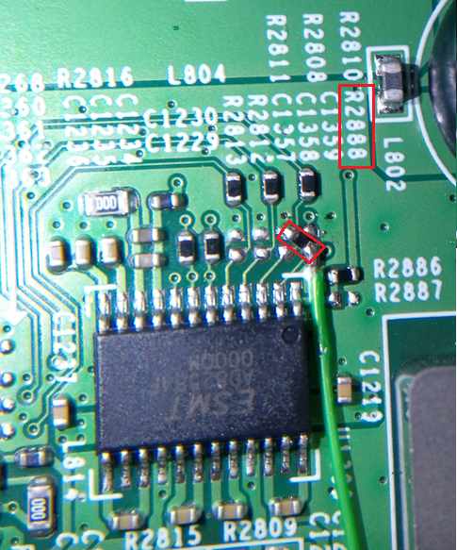
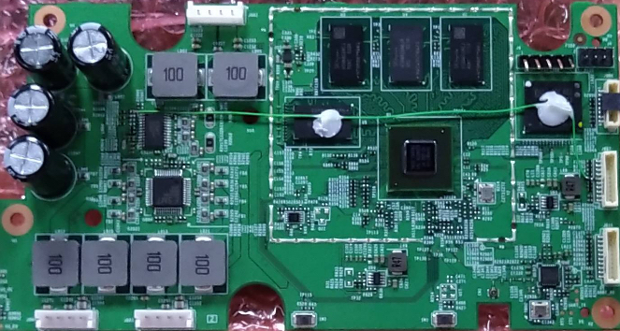
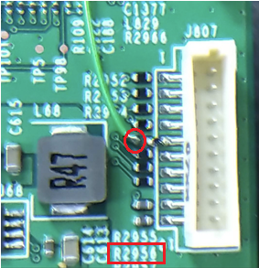
PD pin rework.
PD: Remove R2888 original 0 ohm resistor, and pull 10K ohm to GND.
Pin 1 of R2956
GPIO 32: Use Volume up key to be used for PD pin.
Please remove R2956 first, then connect PD pin to pin 1 of R2956.

Slide 10
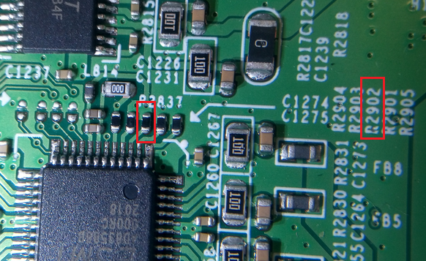
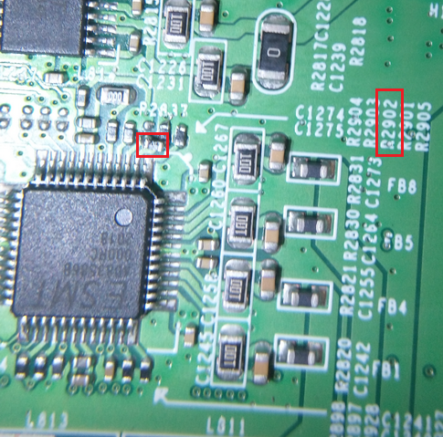
PLL pin rework.
AD83586B’s PLL pin original design, R2902 pull 1K to PWR_3V3.
U804
Please remove R2902 first, then mount this resistor (1Kohm) between pin2 and pin 3 of U804.
PLL pin new design,
R2902 pull 1K to GND.

Slide 11
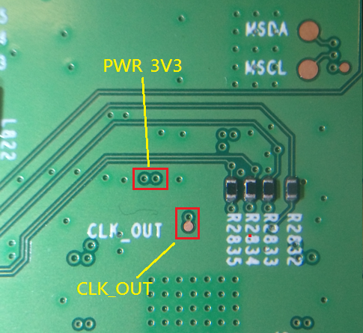
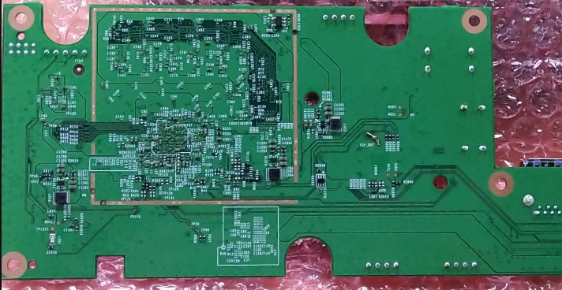
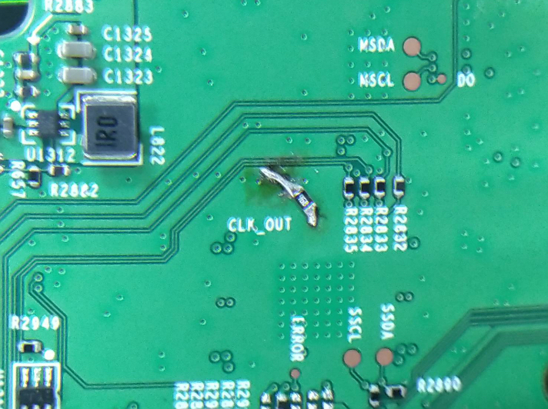
CLK_OUT pin rework.
CLK_OUT: Pull 10Kohm to PWR_3V3.

Slide 12
Rework point of AD83586B/AD83584F audio AMP
1. PIN 3: /PLL
  --> Need to connect a 1K pulled-low RES to GND. This is for using internal PLL. Since the current system MCLK is 24MHz, which can not meet the MCLK frequency requirement of AD83586B.
2. PIN 6: CLK_OUT
  --> Need to connect a 10K pulled-high RES to PWR_3V3, This is to set PLL ratio to one time instead of 4 times to avoid the system MCLK over flow and cause noise issue.
3. PIN 32: /PD
  --> Need to connect it to a normal GPIO instead of always-on SM_GPIO9 (we will rework /PD pin connect to GPIO32, which is used for volume up control in EVT board) , and connected a 10K pulled-low resistor to GND.
  This is used to set the /PD pin remain in low state and ensure that the audio AMP enter to power down mode during the system reboot due to unexpected event.

Slide 13
Volume up/MIC Mute key rework SOP
2020/09/08

Slide 14
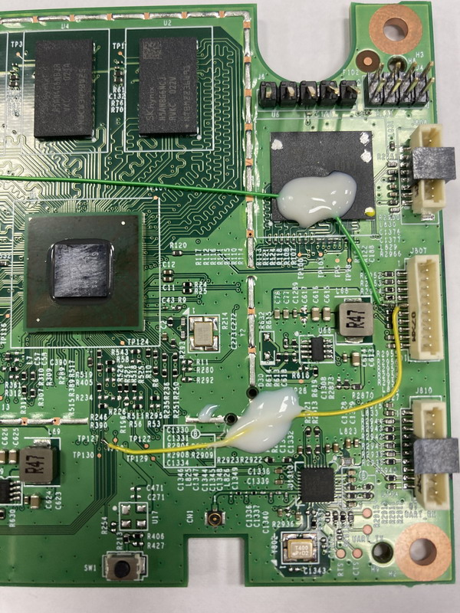
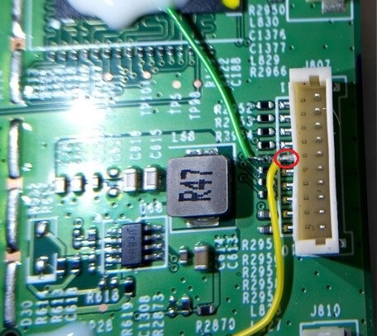
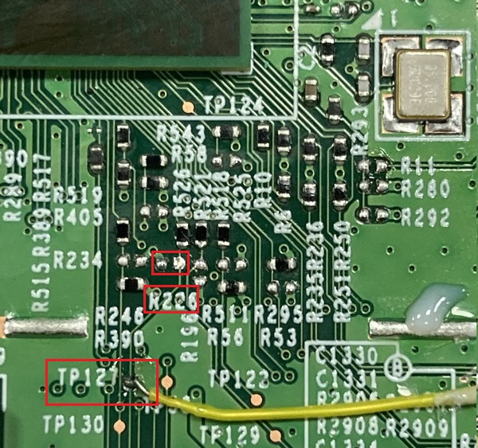
Volume up key rework
Please connect to pin 5 of J807.
SM_GPIO[9]: Use PD pin to be used for Volume up key.
Please connect to TP127 and remove R226 (pull low resistor).

Slide 15
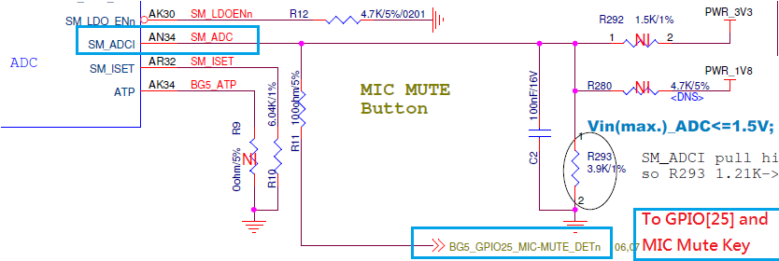
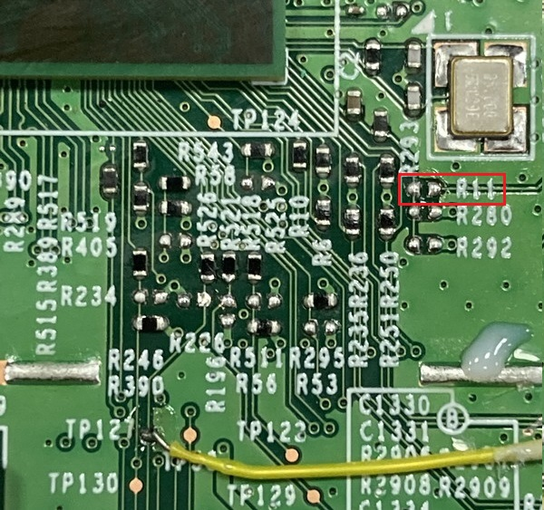
MIC Mute Key Rework
Please remove R11

Slide 16
Rework volume up and MIC mute key
Original design we use GPIO[32] for volume up key control.
Because AMP PD pin control issue when kernel panic, we change GPIO[32] to control PD pin.
For full function key test at EVT1 board, we use SM_GPIO9 to control volume up key.
Original design MIC mute key connect to both SM_ADCI and GPIO[25]. Synaptics FAE said that MIC mute can be controlled by SM_ADCI or GPIO[25]. For easy control reason, our software select GPIO[25] to control MIC mute key.

Slide 17
AUX/MIC Input Circuit rework SOP
2020/09/04

Slide 18
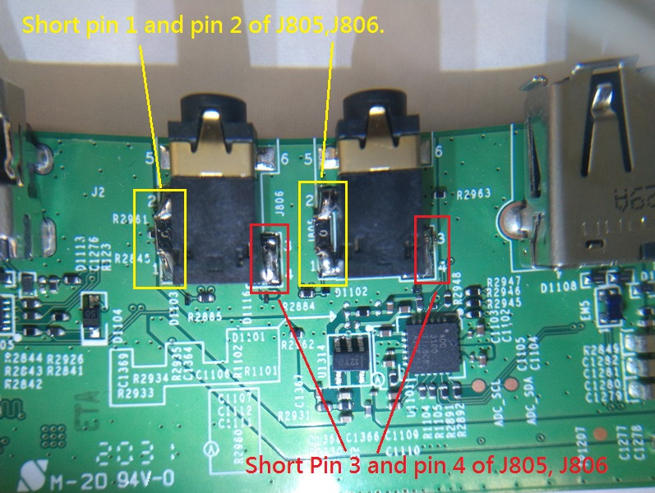
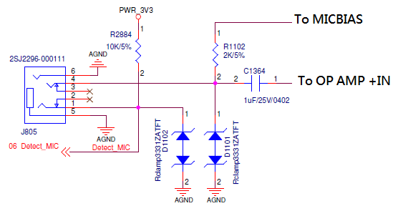
AUX/MIC Input detect and signal pin rework
AUX/MIC input detect rework
Short pin1 and pin2 of J805,J806.
You can use 0ohm/1206 resistor or wire.
Signal pin rework
Short pin3 and pin4 of J805,J806.
J806
J805

Slide 19
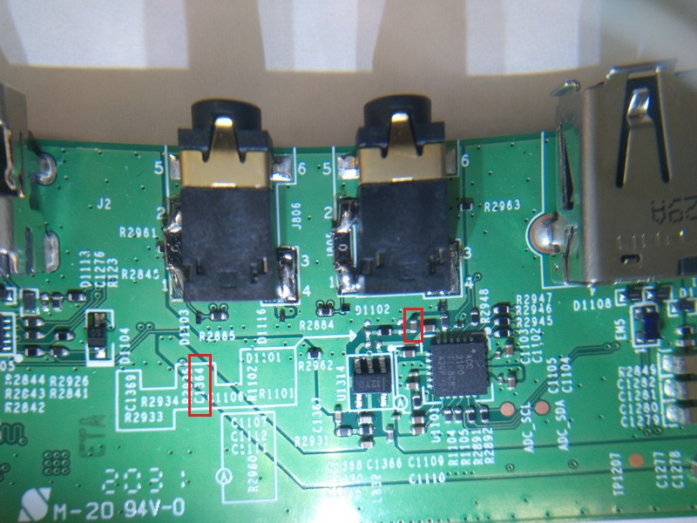
MIC input signal rework
Please remove original 1uF capacitor and mount a 0ohm/0402 resistor on location C1364.

Slide 20
Rework AUX/MIC input circuit
Short pin 1 and pin2, SOC can detect MIC and AUX input.
Short pin 3 and pin4, MIC and AUX signal can transmit to OP AMP and audio ADC.
Short C1364:
Because OP AMP is single power supply (+5V), short C1364 can provide a DC bias to +IN pin of OP AMP, avoid voice distortion.

